Slide 1


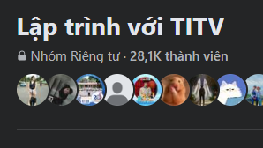




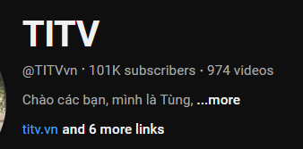



Le Nhat Tung – Email: tungln4@fpt.edu.vn
Master in
Information systems
Master in Data science
and business analytics

